Slide 1
Constraint Satisfaction
Chen-Yu Wei

Slide 2
Revised Assignment Policies
7 free late days (originally 5)
Late days for each homework cannot exceed 7
We will release / discuss solutions one week after the deadline
Exception: Homework3.choices does not allow any late submission.
Further extensions are made in very rare cases
Doctor proof or proof of emergency is required
We count the late days for the choices part and programming part separately
Each part has 7 free late days
Need NOT notify me when you want to use free late days

Slide 3
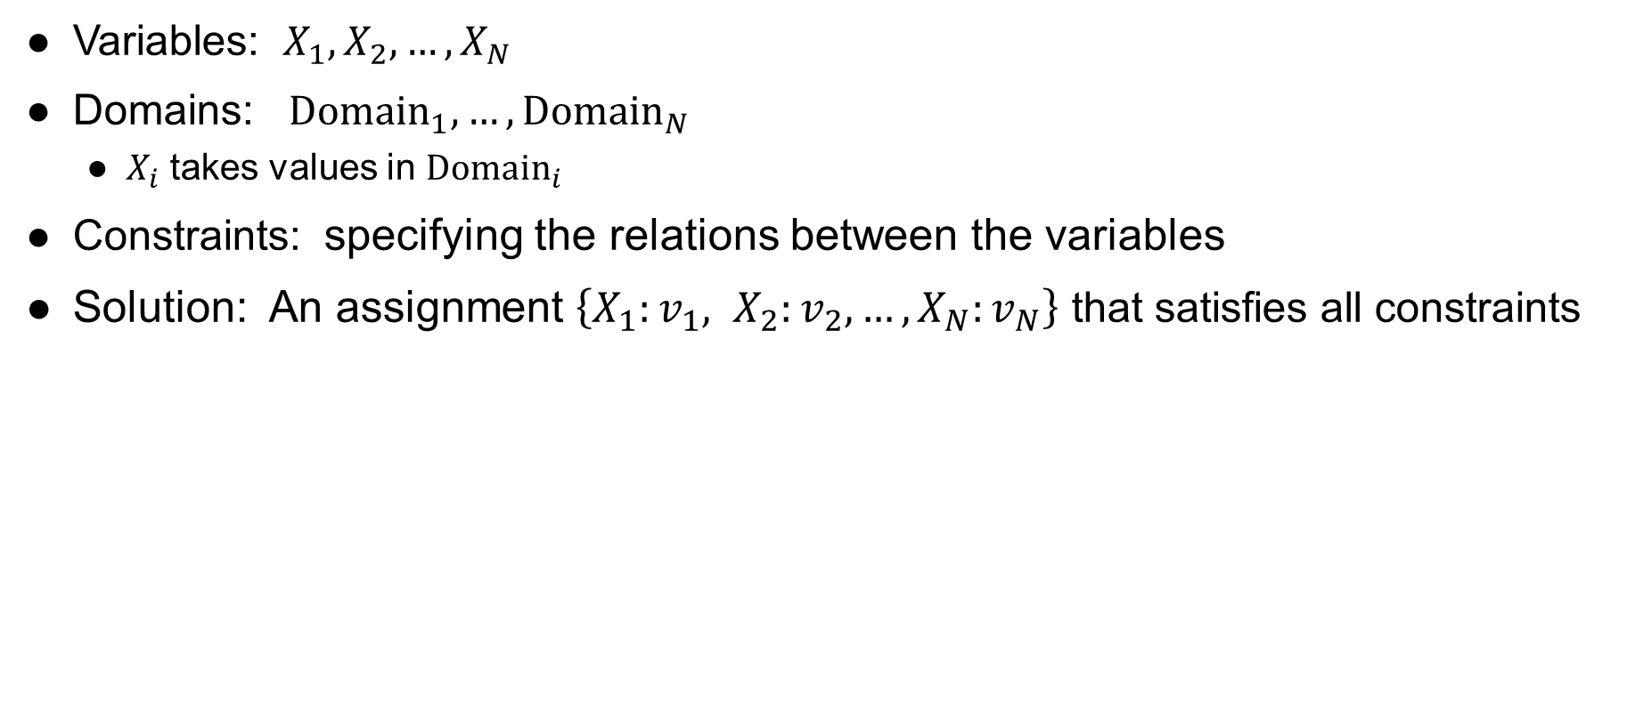
Constraint Satisfaction Problems (CSP)
Variables: $X_{1}, X_{2}, …, X_{N}$
Domains: ${Domain}_{1}, …, {Domain}_{N}$
$X_{i}$ takes values in ${Domain}_{i}$
Constraints: specifying the relations between the variables
Solution: An assignment $\left\{X_{1}:v_{1}, X_{2}:v_{2}, …, X_{N}:v_{N}\right\}$ that satisfies all constraints

Slide 4

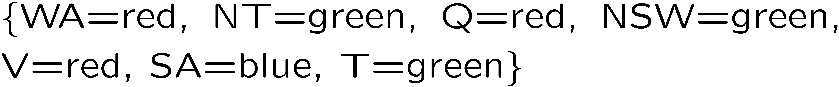
Example: Map Coloring
Variables:
Domains:
Constraints: adjacent regions must have different colors
Solutions are assignments satisfying all constraints, e.g.:
Implicit:
Explicit:

Slide 5

Example: Cryptarithmetic
Variables:
Domains:
Constraints:
Notes:
0=7, R=4, W=6, U=2, T=8, F=1; 867 + 867 = 1734

Slide 6
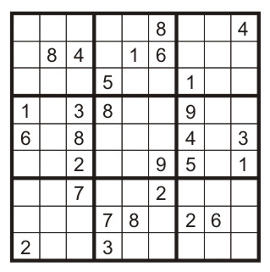
Example: Sudoku
Variables: Each (open) square
Domains: {1,2,…,9}
Constraints:
9-way alldiff for each column
9-way alldiff for each row
9-way alldiff for each region
(or can have a bunch of pairwise inequality constraints)

Slide 7
Real-World CSPs
Assignment problems: e.g., who teaches what class
Timetabling problems: e.g., which class is offered when and where?
Hardware configuration
Transportation scheduling
Factory scheduling
Circuit layout
…
Many real-world problems involve real-valued variables

Slide 8
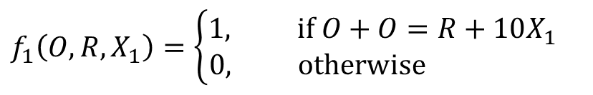
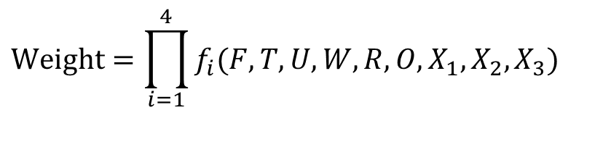
Factor Graph
Variable
Factor
$$Weight=\prod_{i=1}^{4}{f_{i}(F,T,U,W,R,O,X_{1},X_{2},X_{3})}$$
$$f_{1}\left(O,R,X_{1}\right)=\left\{\begin{aligned}1, if O+O=R+10X_{1} \\ 0, otherwise \end{aligned}\right.$$

Slide 9
Constraint Graph
constraint
Variable
(more convenient for binary constraint CSPs)
Every constraint involves at most 2 variables

Slide 10
How to Solve CSP?
Treat it as a search problem
Assign one variable at a time
State: A partial assignment
Action: Assign value to an unassigned variable
Goal test: check whether all constraint are satisfied
But there’s more structure to leverage
Variable ordering doesn’t matter
Variables are interdependent in a local way
We will start from known search algorithms, and try to speed it up

Slide 11
Backtracking Search

Slide 12




Backtracking Search
Backtracking search = DFS + failure-on-violation
BacktrackingSearch({ }, $Domain$) returns an assignment or reports failure.
BacktrackingSearch($x, Domain$):
If $x$ is a complete assignment: return $x$.
Let $X_{i}$ be the next unassigned variable.
For each value $v∈{Domain}_{i}$:
$x^{′}←x∪\left\{X_{i}:v\right\}$
If $x^{′}$ violates constraints: continue
return BacktrackingSearch($x^{′}$, $Domain$)
return failure

Slide 13
Improving Backtracking Search
Forward checking
Maintaining arc consistency (more powerful than forward checking)
Dynamic ordering

Slide 14
Vanilla Backtracking Search
Suppose we assign the variables in the order of
WA, Q, V, NT, NSW, SA
WA
NT
Q
NSW
V
SA
No valid assignment for SA.
Then the algorithm backtracks to try other assignments…

Slide 15
Forward Checking
Cross off values that violate a constraint when added to the existing assignment
WA
NT
Q
NSW
V
SA
Inconsistency found for SA (even though we haven’t reached the layer of SA).

Slide 16


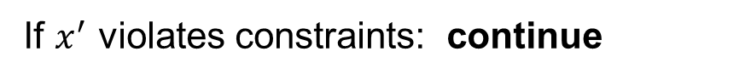
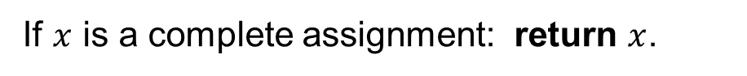
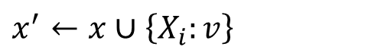


Forward Checking
BacktrackingSearch($x, Domain$):
If $x$ is a complete assignment: return $x$.
Let $X_{i}$ be the next unassigned variable.
For each value $v∈{Domain}_{i}$:
$x^{′}←x∪\left\{X_{i}:v\right\}$
If $x^{′}$ violates constraints: continue
return BacktrackingSearch($x^{′}, Domain′$)
return failure

Slide 17
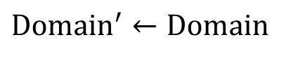



Forward Checking
BacktrackingSearch($x, Domain$):
If $x$ is a complete assignment: return $x$.
Let $X_{i}$ be the next unassigned variable.
For each value $v∈{Domain}_{i}$:
$x^{′}←x∪\left\{X_{i}:v\right\}$
${Domain}^{′}, Consistent=$ForwardChecking($x^{′}, X_{i}, v, Domain$)
If not $Consistent$: continue
return BacktrackingSearch($x^{′}, Domain′$)
return failure
ForwardChecking ($x^{′}, X_{i}, v, Domain$):
$${Domain}^{′}←Domain$$
For all $X_{j}$ that is unassigned in $x′$ and connected to $X_{i}$:
Delete values in ${Domain}_{j}^{′}$ that are inconsistent with $\left\{X_{i}:v\right\}$
If ${Domain}_{j}^{′}$ is empty: return ${Domain}^{′},False$
return ${Domain}^{′}, True$

Slide 18
Can We Prune Even More?
With forward checking:
WA
NT
Q
NSW
V
SA
After assigning Q with green, NT and SA’s domains are left with only blue.
But NT and SA are neighbors, so there is no consistent assignment from here.
How can we detect such inconsistency at this step?

Slide 19

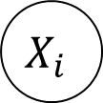
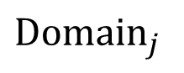
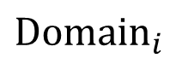
Arc Consistency
$$X_{i}$$
$$X_{j}$$
$${Domain}_{i}$$
$${Domain}_{j}$$
Fact. Let $v∈{Domain}_{i}$ be such that for all $w∈{Domain}_{j}$, $\left\{X_{i}:v, X_{j}:w\right\}$ violates the constraint on $(X_{i}, X_{j})$. Then we can remove $v$ from ${Domain}_{i}$.
Definition (Arc Consistency on $X_{i}→X_{j}$). For all $v∈{Domain}_{i}$, there is some $w∈{Domain}_{j}$ such that $\left\{X_{i}:v, X_{j}:w\right\}$ satisfies the constraint on $(X_{i}, X_{j})$.
Idea to prune more: keep checking whether we can remove elements from any Domain using the fact above. (i.e., always maintaining arc consistency)

Slide 20
Maintaining Arc Consistency (MAC)
Forward checking: maintaining arc consistency from unassigned variables to newly assigned variables.
NT
Q
WA
SA
NSW
V

Slide 21
Maintaining Arc Consistency (MAC)
We can prune more if we ensure arc consistency for all arcs.
Remember: Delete from the tail!
NT
Q
WA
SA
NSW
V
If X’s domain changes, neighbors of X need to be rechecked!

Slide 22

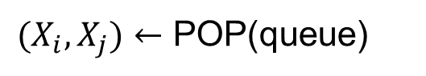




Maintaining Arc Consistency (MAC)
AC3:
queue $←$ initial queue
while queue not empty:
$(X_{i}, X_{j})←$ POP(queue)
if arc $X_{i}→X_{j}$ is not consistent:
Revise ${Domain}_{i}^{}$ to make it consistent
if ${Domain}_{i}^{}$ is empty: return $False$
for each $X_{k}$ connected to $X_{i}$:
add ($X_{k}, X_{i}$) to queue
return $True$

Slide 23
Arc Consistency in Map Coloring Problems
Useful when there is only one color left at the arc head
Actually, this is also the only useful case in the map coloring problem

Slide 24
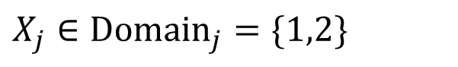
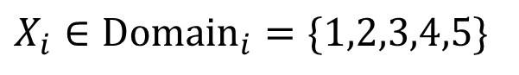
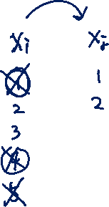

Arc Consistency in Other Problems
$$X_{i}∈{Domain}_{i}=\{1,2,3,4,5\}$$
$$X_{j}∈{Domain}_{j}=\{1,2\}$$
Constraint: $X_{i}+X_{j}=4$

Slide 25
Limitations of Arc Consistency
Some failure modes cannot be detected by arc consistency.
Therefore, we still need “backtracking”.

Slide 26



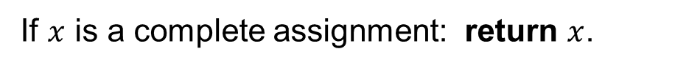
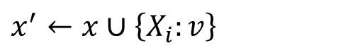


Maintaining Arc Consistency (MAC)
Combining AC3 with backtracking search:
BacktrackingSearch($x, Domain$):
If $x$ is a complete assignment: return $x$.
Let $X_{i}$ be the next unassigned variable.
For each value $v∈{Domain}_{i}$:
$x^{′}←x∪\left\{X_{i}:v\right\}$
${Domain}^{′}, Consistent=$AC3($x^{′}, X_{i}, v, Domain$)
If not $Consistent$: continue
return BacktrackingSearch($x^{′}, Domain′$)
return failure

Slide 27


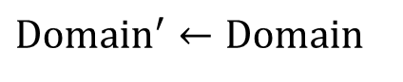


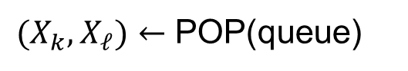

Maintaining Arc Consistency (MAC)
AC3($x^{′}, X_{i}, v, Domain$):
$${Domain}^{′}←Domain$$
queue $←$ {$\left(X_{j}, X_{i}\right)$ for all $X_{j}$ that is unassigned in $x^{′}$ and connected to $X_{i}$}
while queue not empty:
$(X_{k}, X_{ℓ})←$ POP(queue)
if arc $X_{k}→X_{ℓ}$ is not consistent:
Revise ${Domain}_{k}^{′}$ to make it consistent
if ${Domain}_{k}^{′}$ is empty: return ${Domain}^{′}, False$
for each $X_{m}$ that is unassigned in $x^{′}$ and connected to $X_{i}$:
add ($X_{m}, X_{k}$) to queue
return ${Domain}^{′}, True$

Slide 28
Maintaining Arc Consistency (MAC)
Drawbacks of backtracking search with arc-consistency check?

Slide 29

Video: Forward Checking

Slide 30
Video: Maintaining Arc Consistency

Slide 31
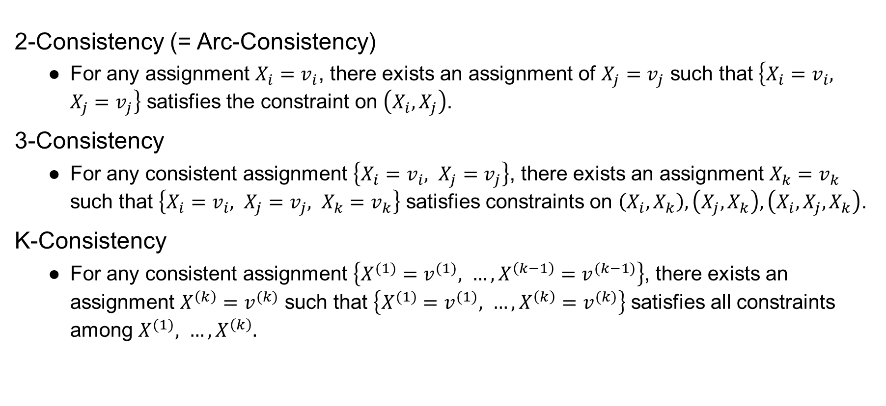
K-Consistency
2-Consistency (= Arc-Consistency)
For any assignment $X_{i}=v_{i}$, there exists an assignment of $X_{j}=v_{j}$ such that $\left\{X_{i}=v_{i}, X_{j}=v_{j}\right\}$ satisfies the constraint on $\left(X_{i}, X_{j}\right)$.
3-Consistency
For any consistent assignment $\left\{X_{i}=v_{i}, X_{j}=v_{j}\right\}$, there exists an assignment $X_{k}=v_{k}$ such that $\left\{X_{i}=v_{i}, X_{j}=v_{j}, X_{k}=v_{k}\right\}$ satisfies constraints on $\left(X_{i}, X_{k}\right),\left(X_{j}, X_{k}\right), \left(X_{i},X_{j},X_{k}\right)$.
K-Consistency
For any consistent assignment $\left\{X^{(1)}=v^{(1)}, …, X^{\left(k−1\right)}=v^{(k−1)}\right\}$, there exists an assignment $X^{\left(k\right)}=v^{(k)}$ such that $\left\{X^{(1)}=v^{(1)}, …, X^{\left(k\right)}=v^{(k)}\right\}$ satisfies all constraints among $X^{(1)}, …, X^{\left(k\right)}.$

Slide 32
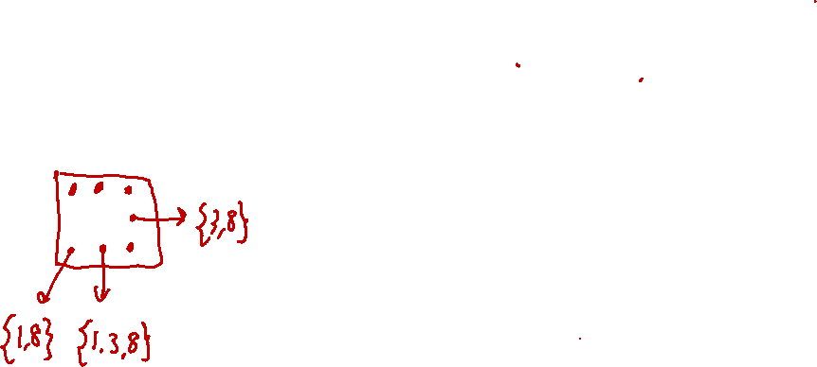
“Naked Triples” Strategy in Sudoku
In any units (i.e., row, column, or box), find three squares each have a domain that contains the same three numbers or subset of these three numbers e.g., the three domains might be {1,8}, {3,8}, {1,3,8}
Eliminate these three numbers from the domains of all other squares in the same unit.
The idea is similar to checking K-consistency: For any assignment that assigns 1 or 3 or 8 to other squares (blue dots on the left figure), there is no feasible solution for the chosen three squares (red dots). Therefore, 1, 3, 8 can be eliminated from other squares’s domains.

Slide 33
Improving Backtracking Search
Forward checking
Maintaining arc consistency (more powerful than forward checking)
Dynamic ordering

Slide 34



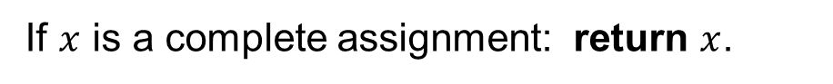
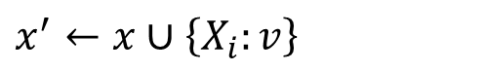


Ordering
BacktrackingSearch($x, Domain$):
If $x$ is a complete assignment: return $x$.
Let $X_{i}$ be the next unassigned variable.
Which variable should we pick first?
For each value $v∈{Domain}_{i}$:
Which value should we try first?
$x^{′}←x∪\left\{X_{i}:v\right\}$
${Domain}^{′}, Consistent=$AC3($x^{′}, X_{i}, v, Domain$)
If not $Consistent$: continue
return BacktrackingSearch($x^{′}, Domain′$)
return failure

Slide 35

Variable Ordering

Slide 36
Variable Ordering
Minimum Remaining Value (MRV) heuristic
Choose variable that has the fewest left values in its domain.
Why?
Must assign every variable
If going to fail, fail early → more pruning

Slide 37



Variable Ordering

Slide 38
Variable Ordering
WA
NT
Q
NSW
V
SA
WA
NT
Q
NSW
V
SA

Slide 39
Variable Ordering
Degree heuristic
Choose variable that is involved in the largest number of constraint.
Could be a good tie-breaking strategy along with MRV.

Slide 40

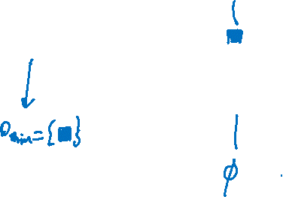
Value Ordering

Slide 41
Value Ordering
Least Constrained Value (LCV) heuristic
Choose the value that rules out the fewest values in the remaining variables.
Can be estimated by forward checking or arc-consistency checking
Why?
Needs to choose some value
Choosing value most likely to lead to solution
Unlike variable ordering, there is no need to consider all values

Slide 42
Ordering
Minimum Remaining Value (MRV) heuristic
Choose variable that has the fewest left values in its domain.
Degree heuristic
Choose variable that is involved in the largest number of constraint.
Least Constrained Value (LCV) heuristic
Choose the value that rules out the fewest values in the remaining variables.

Slide 43
Local Search

Slide 44
Iterative Improvement
Start from some complete assignment that may not satisfy all constraints
Modify the assignment, trying to resolve violations

Slide 45

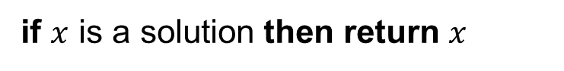

Iterative Improvement
MinConflict (MaxSteps):
$x←$ an initial complete assignment
for iter = 1 to MaxStep:
if $x$ is a solution then return $x$
Let $X_{i}$ be a randomly chosen conflicted variable
Let $v$ be the value for $X_{i}$ that minimizes conflicts
Reassign $X_{i}=v$ in $x$

Slide 46
Iterative Improvement

Slide 47





Failure of MinConflict
{1,2,3}
{1,2,3}
1
2
3
3
$$≠$$
$$≠$$
{1,2,3}
3
1
$$≠$$
$$≠$$
$$≠$$
1
2
1
2
{1,2}
{1,2}
A feasible solution
An unfortunate initialization for MinConflict

Slide 48
Rescue
For local search algorithms like MinConflict, we will randomly generate multiple initial assignments. For each initial assignment, we will only run it for MaxStep iterations before giving up.

Slide 49
Homework 2
Xuhui Kang, Matthew Landers
Deadline: 11:59PM, September 30

Slide 50
Homework 2
Choice Questions (10 points)
10 questions.
Answer directly on Gradescope
The same requirements as the last time.
1 feedback box for the course
Program Questions (25 points)

Slide 51
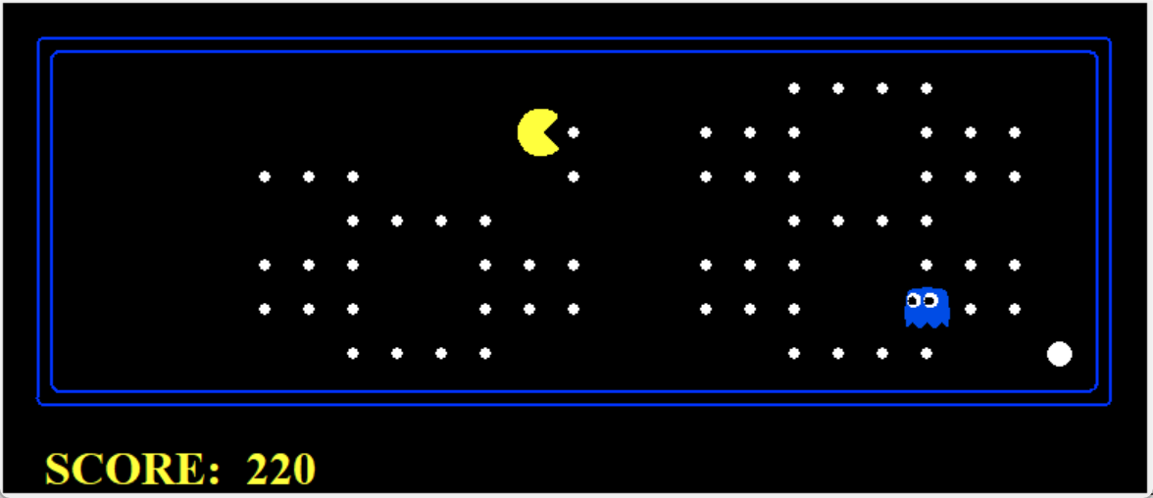
Question 1 (4 points): Reflex Agent
Your agent should easily and reliably clear the layout:
Run 10 times for evaluation:
TO receive full credits:
Wins all the 10 times
Average score is greater than 1k.

Slide 52
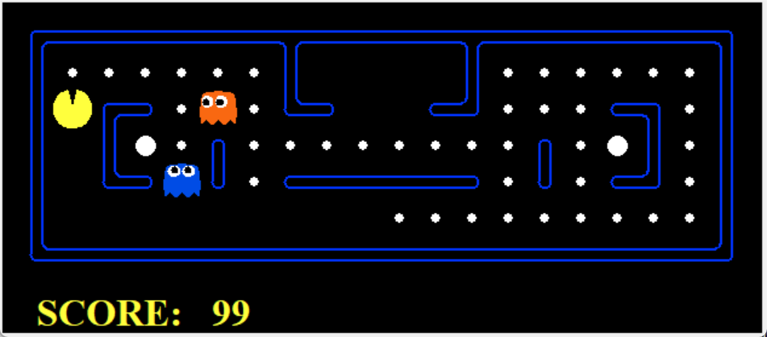
Question 2 (5 points): Minimax
You will write an adversarial search agent.
Work with any number of ghosts:
Check the number of ghosts first.
Index 0 is always the Pacman.
Correct implementation will lead to Pacman losing the game in some tests.
In large boards, Pacman will be good at not dying but bad at winning. It is not a problem.
When the Pacman believes that his death is unavoidable. Hw will try to end the game as soon as possible.

Slide 53
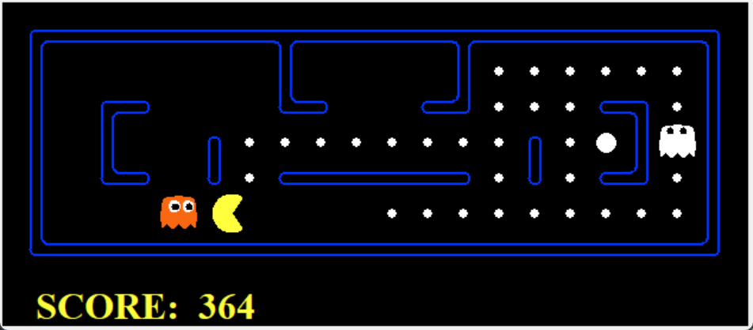
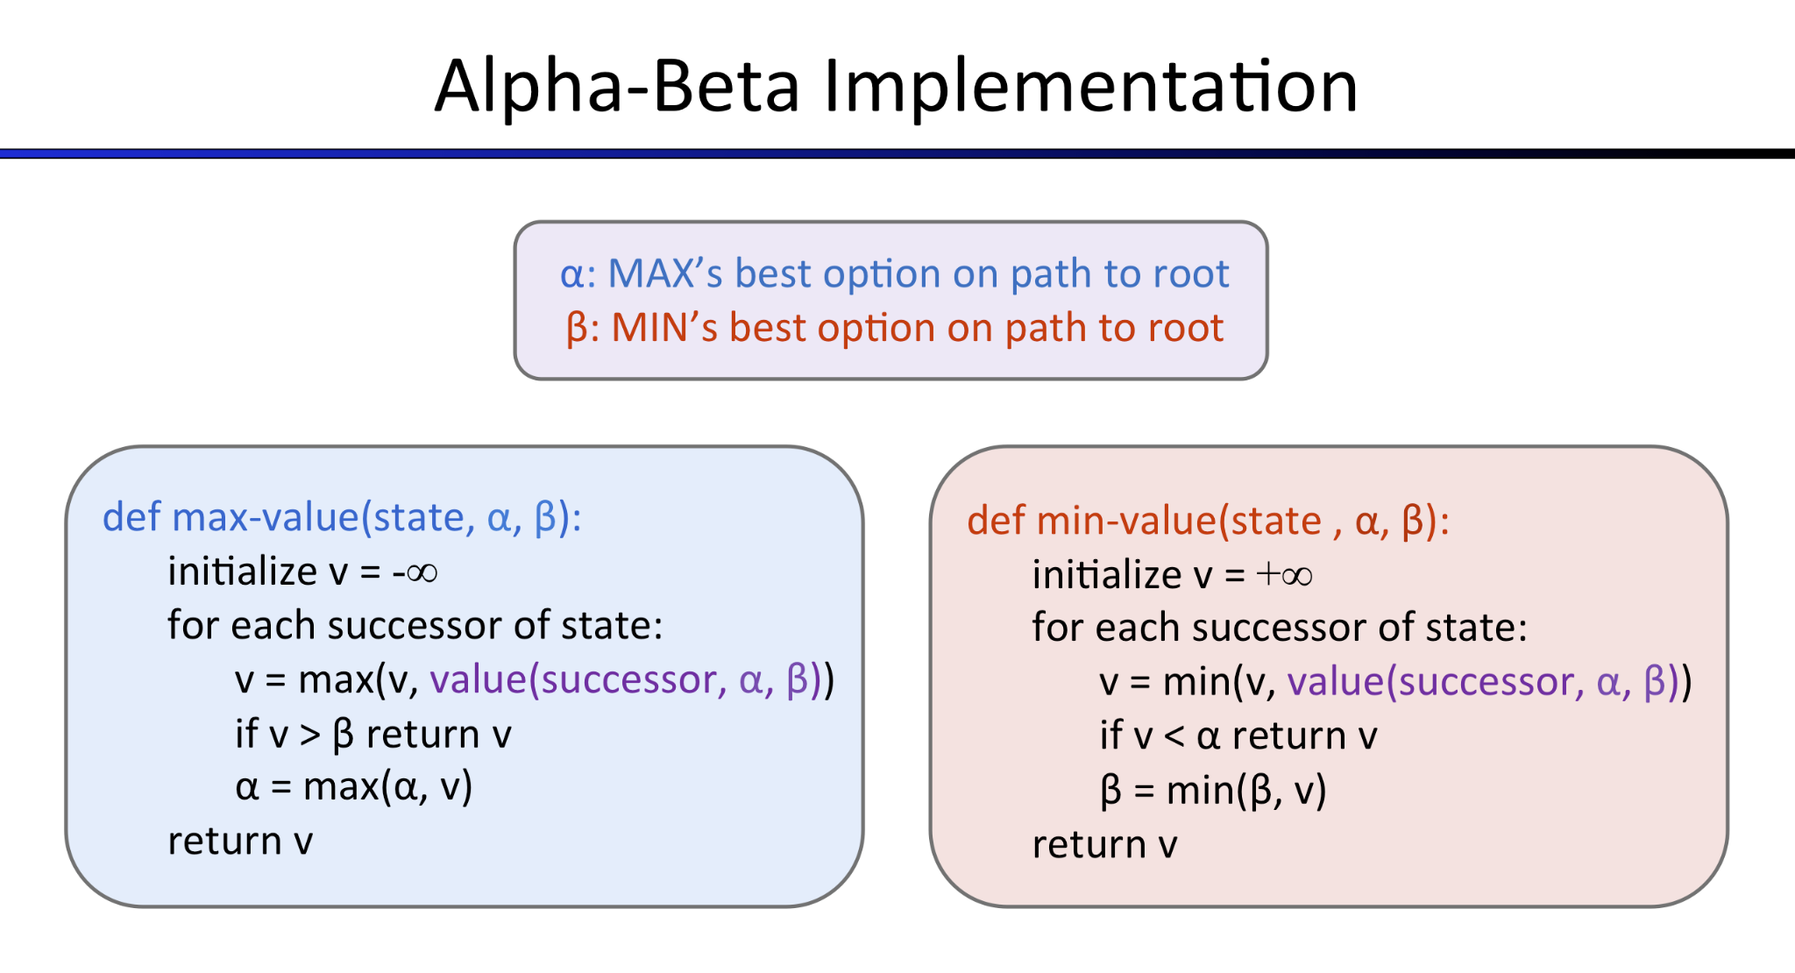
Question 3 (5 points): Alpha-Beta Pruning
Uses alpha-beta pruning to more efficiently explore the minimax tree.

Slide 54
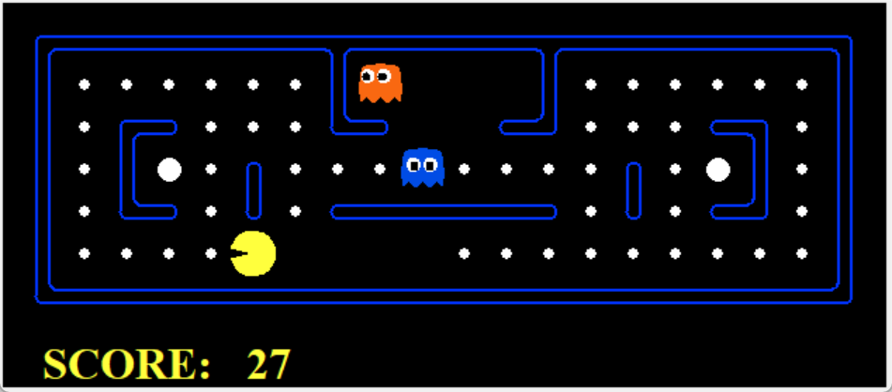
Question 4 (5 points): Expectimax
Implement Expectimax Agent to modeling the probabilistic behavior of agents who may make suboptimal choices.
Correct implementation will lead to Pacman losing the game in some tests.

Slide 55
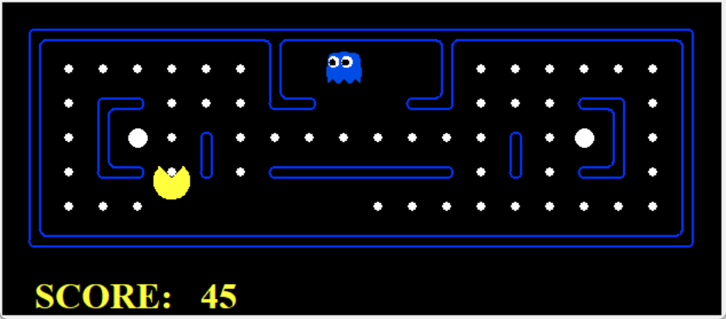
Question 5 (6 points): Evaluation Function
The evaluation function should evaluate states, rather than actions like your reflex agent evaluation function did.
You can use your search code in last project for evaluation.

